Slide 1
Honden

Slide 2
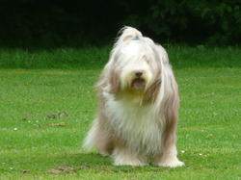
Bearded Collie

Slide 3
Duitse herdershond

Slide 4
Boxer

Slide 5
Dobermann

Slide 6
Shar-pei

Slide 7
Border Collie

Slide 8
Flatcoated retriever

Slide 9
Labrador retriever

Slide 10
Chow Chow

Slide 11
Keeshond

